Slide 1
“ENERGY TAG” STREAMLINING EV BATTERY PRICING

Slide 2
Agenda
Introduction
Objectives
Need For Battery Management
System Requirements
Block Diagram
Methodology
Results And Discussion
Future Scope
Conclusion

Slide 3
INTRODUCTION
The rapid growth of electric vehicles (EVs) necessitates efficient battery management. "Energy Tag" aims to streamline EV battery swapping using RFID, voltage sensors, and automation for better user experience and efficiency.
Energy Tag introduces dynamic pricing using real-time data from RFID-tagged batteries. This ensures fair pricing based on battery condition, displayed clearly to users.
This approach revolutionizes EV infrastructure, promoting sustainability and efficiency in battery management, and supports a cleaner, greener future
Hence, Battery swapping reduces downtime by allowing quick battery exchanges.

Slide 4
THE NEED FOR EFFICIENT BATTERY MANAGEMENT
Challenges with fixed pricing models.
Importance of accounting for battery health and usage in pricing.

Slide 5


OBJECTIVES
Develop a pricing strategy based on real-time battery data.
Ensure the system is adaptable to varying battery conditions.
Enhance transparency and fairness in battery swapping centers.

Slide 6
System Requirements:
Hardware requirements:
Batteries with voltage sensors
9V power supply
ESP32 development kit
LCD display
RFID sensor
Software Requirements:
Arduino Integrated Development Environment (IDE)
Web server for slot booking and data management

Slide 7


Batteries: Equipped with voltage sensors to monitor health
Description of battery specifications and types used.
Importance of battery health data in dynamic pricing.
Voltage Sensors: Measure and report the charge level and health of batteries
Types of voltage sensors used and their accuracy.
Role of voltage data in determining battery condition.
9V Power Supply: Provides necessary power to the ESP32 and other components
Ensures stable power for reliable system performance.
ESP32 Development Kit: Central control unit for processing and communication
Key features of ESP32 (Wi-Fi capability, processing power).
Its role in data processing and communication with other components.

Slide 8

LCD Display: Shows real-time information to users
User interface design for clear and intuitive information display.
RFID Sensor: Reads RFID tags on batteries to identify and track them
How RFID technology helps in unique identification and tracking.
Web Server: Manages slot booking, data storage, and pricing calculations
Backend infrastructure for data management and user interface.
Security measures for data protection and user privacy.
The Arduino IDE: It is a cross-platform application for writing, compiling, and uploading code to Arduino boards. It provides an intuitive interface and essential tools for programming microcontrollers.

Slide 9
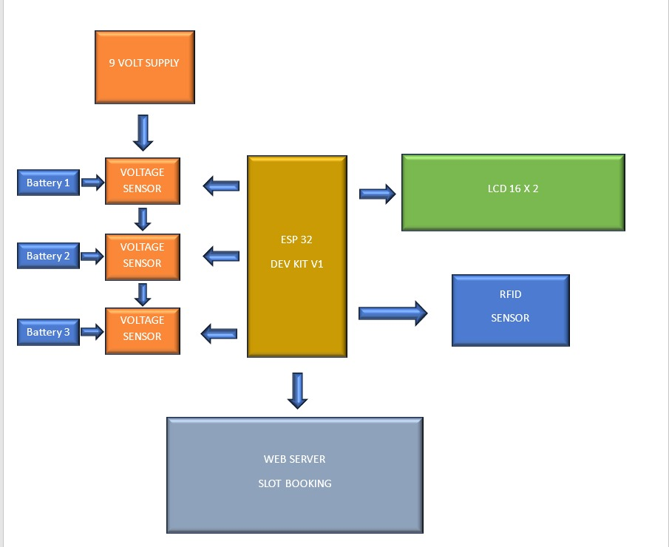
Block diagram
This diagram illustrates a system for pricing of EV batteries using RFID at battery swapping centers.

Slide 10


The block diagram consists of three batteries monitored by voltage sensors, powered by a 9V supply, controlled by an ESP32 DEV KIT V1.
ESP32 DEV KIT: Central unit managing battery data from sensors, controlling LCD display, RFID sensor, and connecting to a web server.
RFID Sensor: Identifies batteries via RFID tags for tracking and management.
LCD Display: Provides real-time battery status and transaction information to users.
Web Server: Manages data including battery usage history and implements dynamic pricing based on battery condition.
Process Flow: User swaps battery, RFID identifies it, ESP32 reads data, updates web server with transaction details and calculates dynamic price, user completes transaction based on calculated price.

Slide 11
METHODOLOGY
1.Data Collection: Real-time data from voltage sensors and RFID tags is crucially stored and used for accurate pricing decisions.
2. Data Processing: Battery health is analyzed using algorithms that consider charge cycles and voltage levels, influencing dynamic pricing.
3.Pricing Algorithm: Pricing calculations are based on current battery conditions, with examples illustrating pricing variations.
4.User Interaction: Interfaces on LCD and web server facilitate intuitive battery swapping, guided by RFID identification and transaction confirmation.
5.System Integration: The ESP32 orchestrates seamless integration of sensors and server communications for reliable system performance.

Slide 12
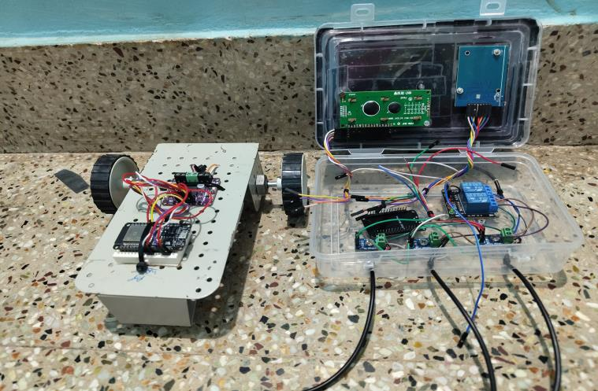
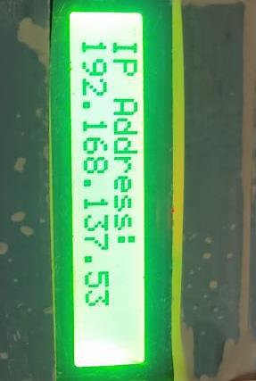
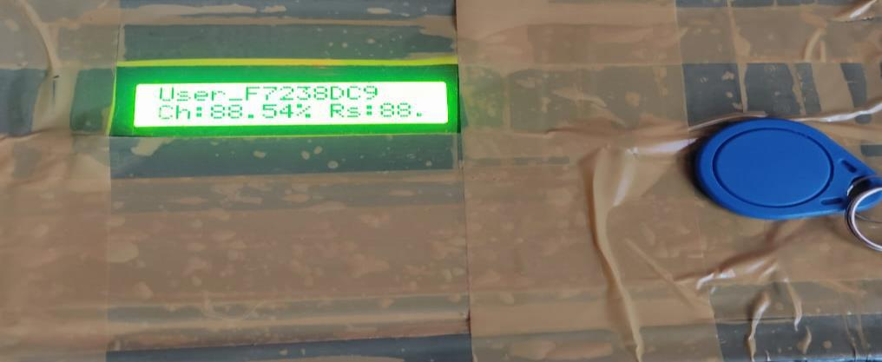
RESULTS AND DISCUSSION:

Slide 13
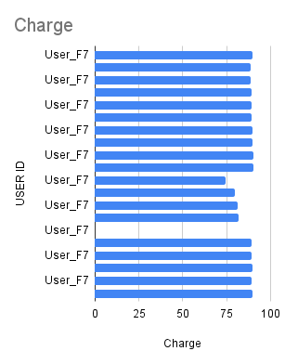
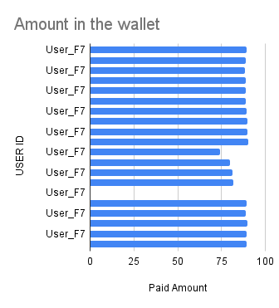
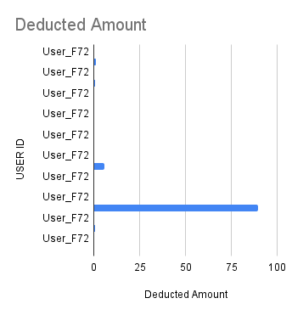
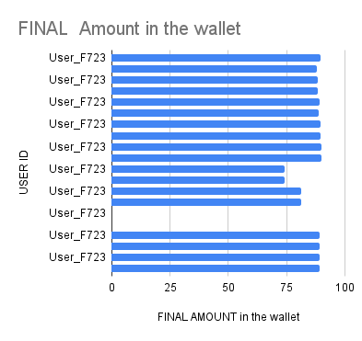

Slide 14
FUTURE SCOPE:
In the future, the project aims to advance battery monitoring with techniques like Coulomb counting and impedance spectroscopy for accurate state-of-charge estimation. Additionally, enhancing the user interface through mobile apps or web portals can improve the overall experience. Remote management capabilities will enable administrators to monitor battery status and usage remotely, with analytics offering insights for optimization. Integration of IoT technology can facilitate proactive maintenance and fault detection. Further, collaboration with EV manufacturers for standardization and expansion to multiple locations will promote widespread adoption and sustainability

Slide 15
CONCLUSION:
The "Energy Tag - Streamlining EV Battery Prices in Battery Swap Stations" project successfully integrates hardware and software components to create an efficient, user-friendly battery swap station. By leveraging the ESP32's capabilities, RFID technology, and WiFi connectivity, the system ensures accurate user identification, real-time transaction processing, and seamless data management. The use of LCD displays enhances the user interface, providing clear instructions and status updates. Voltage sensors and relays efficiently manage the battery charging and swapping processes, ensuring safe and reliable operation. The implementation of a web server allows for convenient slot booking and monitoring, enhancing user experience and operational efficiency. The integration with Google Sheets for data logging ensures accurate record-keeping and facilitates analysis for future improvements. Overall, the project demonstrates a robust solution for managing EV battery swaps, providing a scalable model that can be expanded and adapted for broader applications in the EV charging infrastructure. This project paves the way for more efficient energy management systems, contributing to the advancement of sustainable transportation solutions.

Slide 16
Thank you

